Slide 1

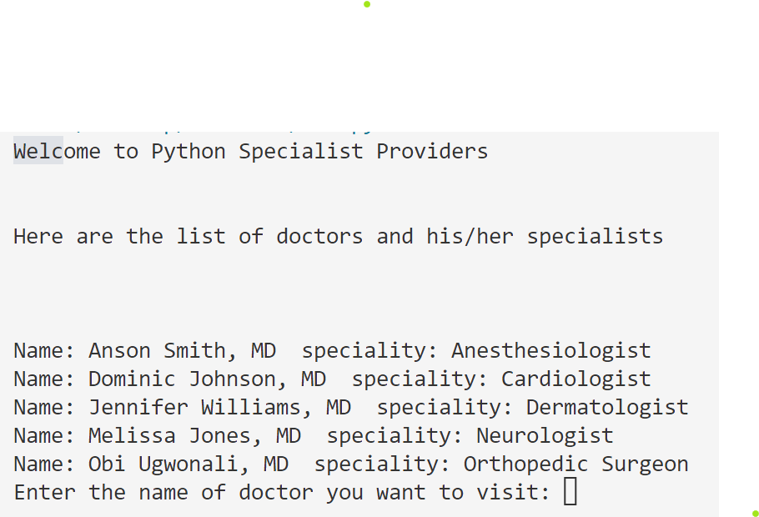

Doctor Patient Scheduler
Team Members:
Marci Sparrow
Melissa Rivera
Gone are the days of calling the doctor’s office to schedule your appointments during business hours. No more waiting on hold while other patients are being assisted. DPS assists you with self-scheduling your appointments during times convenient for you.
Its on your dime, book on your time!

